Slide 1
Information Retrieval in Tech Zone and CSC Content Using Latent Semantic Analysis

Slide 2
What is the Problem?
Hard to find similar CSC's that have been resolved to avoid redundant work
Linking CSC's with TechZone articles are difficult due to propriety taxonomy in Cisco

Slide 3
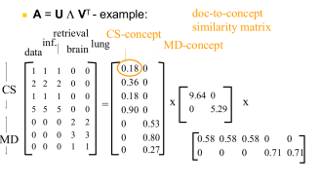
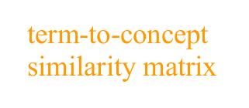
Solution
Extract semantic information from textual and attribute information in order to perform a quantitative similarity analysis between CSC or TZ articles with either query texts or other CSC or TZ articles
Uses Latent Semantic Analysis and TFIDF vectorization
Use Solr and Spark to perform this at very large scale

Slide 4
Recommendation
Historical CSC Discussions
Query terms or web page visits
TFIDF + Latent Semantic Analysis
(Python/Spark)
Solr
Historical Tech Zone Articles
Similar Resolved CSC,
Italics – Partially Implemented

Slide 5
Concept 12:
queue
srr
srr queue
shape
peter
burst
tc
solarwinds
01 21
customer
Concept 19:
tunnel
7600
cisco 7600 series
cisco 7600
7600 series
plus
shape
01 21 2013
mon 01 21
overhead
Concept 27:
sup32
supervisors
bus
thu 03 01
gbps
03 01 2012
t1
voip
thu 03
hosts

